Slide 1
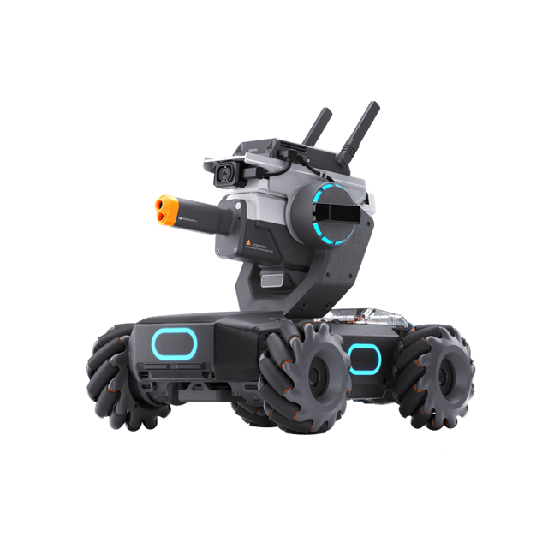
Robomaster
Powered by
Dora-rs

Slide 2
Table of contents
01
02
03
Goals
Demo
Installation
04
05
06
Robot API
Performance
Conclusion
What is the project doing?
Robot navigating through obstacles
What are the challenges?
What can the robot do with its APIs?
How well it’s performing?
Future upgrades, dora, and more

Slide 3
01
The Goals
Allowing the robot to navigate autonomously while avoiding any obstacles.

Slide 4

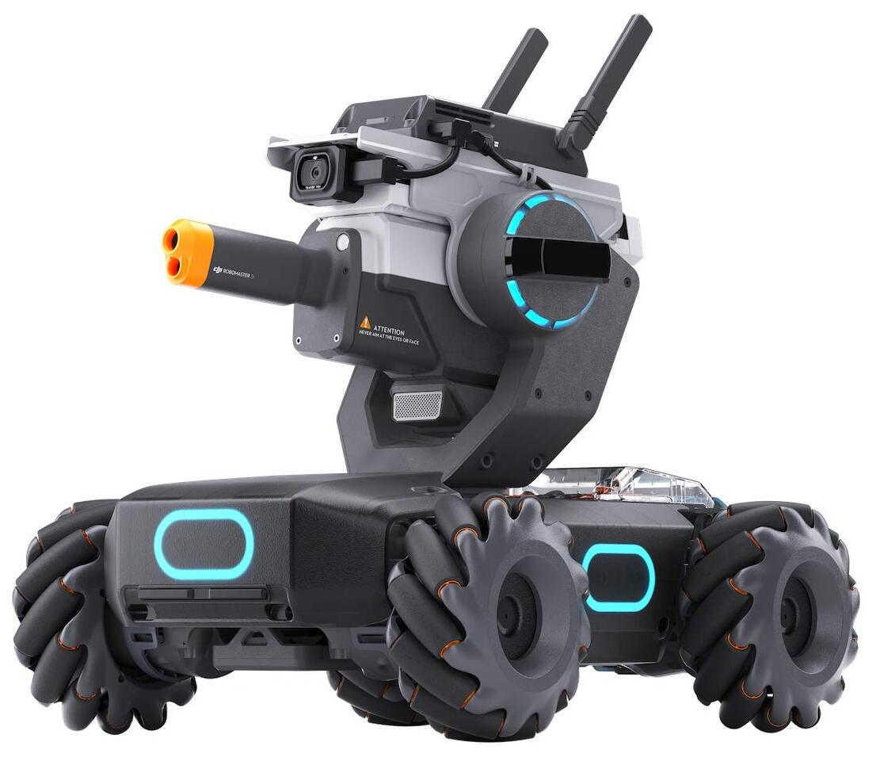

~500$

Slide 5
02
The Demo

Slide 6
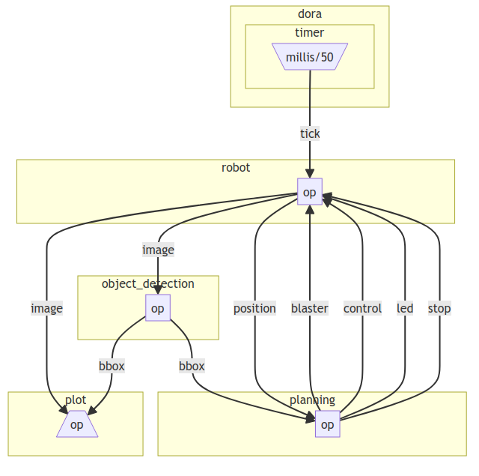

Slide 7
03
The Installation

Slide 8



Slide 9

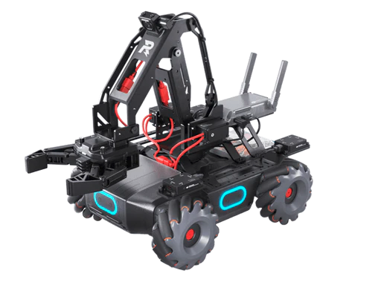

Slide 10
04
The APIs

Slide 11
Wireless connection
Camera
Speaker
Blaster
Led
Gimbal
Armor
Wheels

Slide 12
05
The Performance`

Slide 13
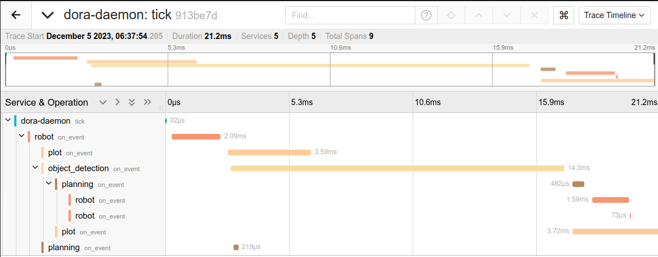

Slide 14
06
Conclusion

Slide 15

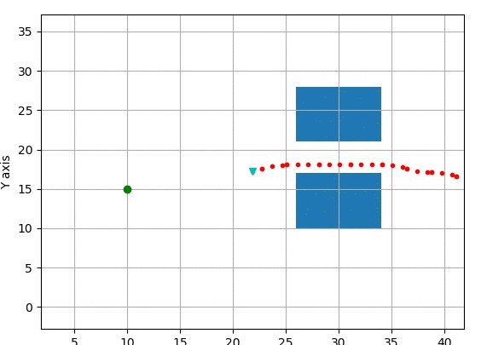
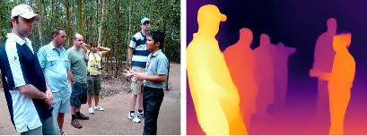
Futures
Depth/Distance
Planner
A lot more!
By implementing MiDaS, the Robomaster can achieve distance calculation
Using a FOT Operator, the robot will be able to calculate the optimal trajectory
The robomaster is flexible enough, a lot of possibilities there is.

Slide 16
THANK YOU FOR LISTENING!
ANY QUESTIONS ?

